Slide 1

Welcome to Year 6
Notes:
Michele

Slide 2
Staff
Class | Teacher
6B | Mrs Bradley
6C | Mrs Cassidy
6H | Mrs Hutson
Additional Staff
Mrs Kelly Mrs Williams Mrs Langston Mrs O’Neill Mrs King Mr Newman
Notes:
Michele Intro class teachers – if part-time / job-share explain the days and any particular responsibilities of each teacher.

Slide 3

Curriculum
RE
Across the year, we will be teaching 6 RE topics.
Creation and Covenant – Old Testament creation story, linked with Science.
Prophecy and Promise – Prominent women in the O.T. linked with Mary.
In addition to our R.E. curriculum, we pray together three times a day and take part in assemblies, masses and liturgies throughout the year. Pupils also regularly plan and lead acts of collective worship in their classes.
We welcome you to watch our Class Collective Worships:
6B – 13th October @ 9am
6H – 16th November @ 9am
6C – 24th November @ 9am
  6D –25th November @ 9am
Notes:
Claire

Slide 4
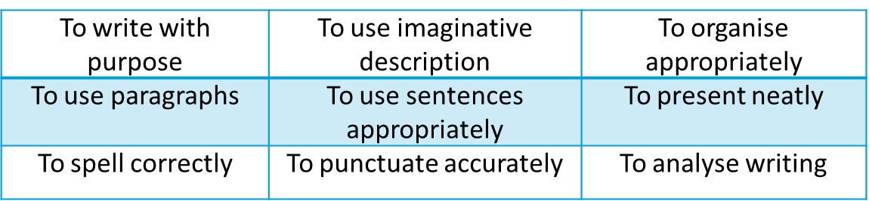
Curriculum
English – Writing and grammar is taught through a range of genres such as: non-fiction, narrative and poetry.
Reading Practice sessions will take place once a week in class.
The key skills in reading are: ‘To read words accurately’ and ‘To understand texts.’
We expect Year 6 children to read daily in school and at home, including reading aloud to an adult.
Reading comprehension homework will be set fortnightly.

Slide 5
Curriculum
Maths – We follow the ‘White Rose’ scheme of learning; teaching the following skills:
Each unit builds on prior learning and homework is set to consolidate the children’s learning.
To know and use numbers | To use fractions | To use statistics
To add and subtract | To understand the properties of shapes | To use algebra
To multiply and divide | To describe position, direction and movement | To use measures

Slide 6
Broad and Balanced Curriculum
Science
Geography
History
Art
Design Technology
RSHE
Music
Computing
French
PE – indoor and outdoor
Please read the curriculum letter at the start of each term – this will provide further information about each subject.
Notes:
Katie

Slide 7
Assessment at Sacred Heart
Our Assessment system is based on the key skills children develop in each subject throughout Year 1 – Year 6.
When we report progress to you, it will be based upon how well children are applying these essential key skills in their learning.
The Key Stage 2 SATs tests are timetabled from:
Monday 10th May to Thursday 13th May 2027.
We will have a parents’ meeting closer to the time.
Notes:
Claire

Slide 8
Homework
Subject | Day Set | Day due in
Reading | Daily
Maths | Friday | Group C Monday Groups B and H Friday
English | Friday | Friday
Spelling | Friday | Friday
Occasionally unfinished classwork and other homework may be set.
Notes:
Katie

Slide 9
Practical Details
Please ensure all uniform and equipment is labelled with child’s name and adheres to the school uniform policy.
PE kits must be worn to school on PE days
6B – Thursday and Friday
6C - Wednesday and Thursday
6H – Thursday
Black or white trainers only, navy tracksuit bottoms/leggings, shorts (mid-thigh length)
No earrings or fancy hair styles (no gel)
Long hair must be plaited
Notes:
Katie

Slide 10
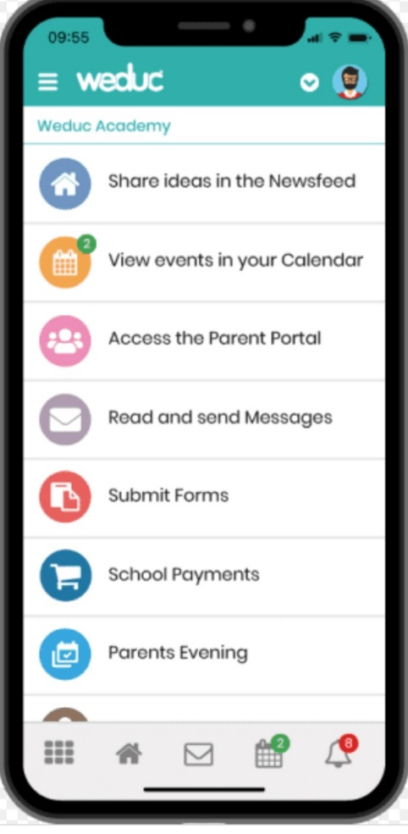

Working Together
Reach More Parents/WEDUC app for notifications.
Year 6 Weekly newsletter with relevant information.
If you have any minor issues you would like to discuss with your class teacher, we are available on Tuesdays between 3:15-3:30 for a drop in.
Please contact the school office if you need to discuss any concerns with your class teacher.
Notes:
Katie

Slide 11
Working Together
The year group email for communication with the teacher is a key communication tool but it is important we use it as effectively as possible.
Please be reminded of the following:
    Email correspondence should only be used to answer important factual questions or to arrange a face-to-face meeting.
    Emails will not be answered immediately, as teachers are in class and are planning and preparing lessons before and after school. Teachers will respond at the earliest opportunity (not including weekends or holidays).
    All emails are checked by the Phase leader/Senior leadership team.
    If you have an urgent concern or complaint then you should email the office. All absences should be recorded via the Reach More Parents/Weduc app, not by email.
    year6@shpsruislip.org
Notes:
are

Slide 12
Any Questions?

